Slide 1
IOT-Based Smart Health Monitoring System
Submitted to: Dr. Ujjaval Patel
Group No -10 Disha Pol -012200300003007 Himil Prajapati – 01220030003011 Pratham Doshi - 01220030003025

Slide 2
INTRODUCTION
IoT is rapidly revolutionizing the healthcare industry. Keeping track of the health status of your patient at home is a difficult task because of the busy schedules and our daily life work.
Our device puts forward a smart patient health tracking system using Web Server so that the Patient health parameters like Heart Rate and Blood Oxygen level along with body temperature can be monitored.

Slide 3
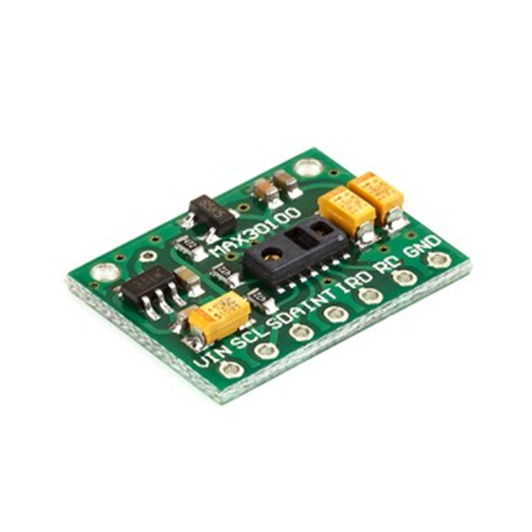
Components Used
Pulse Oximeter and Heart-Rate Sensor (MAX30100)
The MAX30100 is complete pulse oximetry and heart-rate sensor system solution designed for the demanding requirements of wearable devices. The MAX30100 pro-vides very small total solution size without sacrificing optical or electrical performance.
The MAX30100 is fully configurable through software registers, and the digital output data is stored in a 16-deep FIFO within the device. The FIFO allows the MAX30100 to be connected to a microcontroller or microprocessor on a shared bus, where the data is not being read continuously from the device’s registers.

Slide 4
Components Used
SpO2 Subsystem
The SpO2 subsystem in the MAX30100 is composed of ambient light cancellation (ALC), 16-bit sigma-delta ADC, and a proprietary discrete-time filter. The SpO2 ADC is a continuous-time oversampling sigma-delta converter with up to 16-bit resolution. The ADC output data rate can be programmed from 50Hz to 1kHz. The MAX30100 includes a proprietary discrete-time filter to reject 50Hz/60Hz interference and low-frequency residual ambient noise

Slide 5
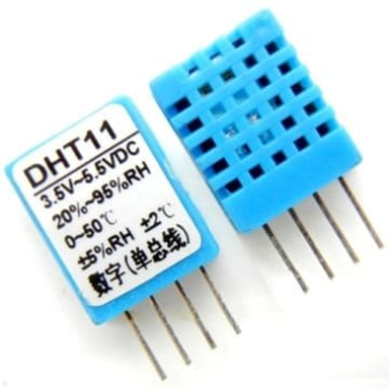
Components Used
DHT11 Humidity & Temperature Sensor
The DHT11 is a basic, ultra low-cost digital temperature and humidity sensor. It uses a capacitive humidity sensor and a thermistor to measure the surrounding air, and spits out a digital signal on the data pin (no analog input pins needed).
It’s fairly simple to use, but requires careful timing to grab data. The only real downside of this sensor is you can only get new data from it once every 2 seconds, so when using the library, sensor readings can be up to 2 seconds old.

Slide 6
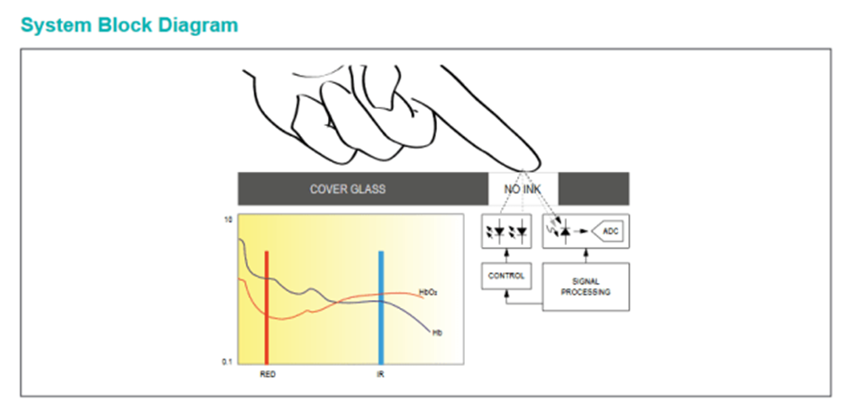
System Block Diagram

Slide 7
Benefits and Features
Complete Pulse Oximeter and Heart-Rate Sensor Solution Simplifies Design
Integrated LEDs, Photo Sensor, and High-Performance Analog Front -End
Tiny 5.6mm x 2.8mm x 1.2mm 14-Pin Optically Enhanced System-in-Package
Ultra-Low-Power Operation Increases Battery Life for Wearable Devices
Programmable Sample Rate and LED Current for Power Savings
Ultra-Low Shutdown Current (0.7μA, typ)
Advanced Functionality Improves Measurement Performance
High SNR Provides Robust Motion Artifact Resilience
Integrated Ambient Light Cancellation
High Sample Rate Capability
Fast Data Output Capability

Slide 8
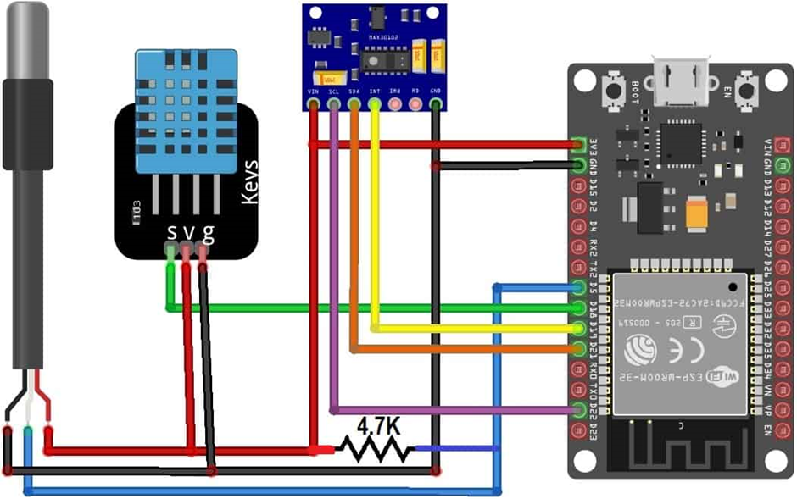
Circuit Diagram

Slide 9
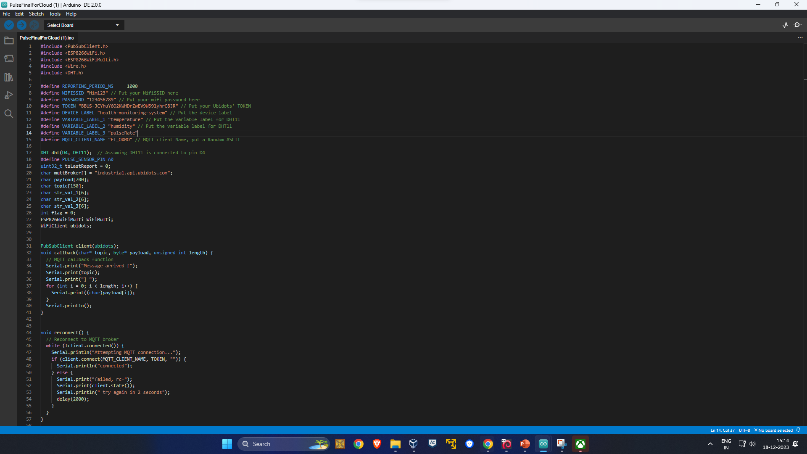
Ubidots Cloud Code

Slide 10
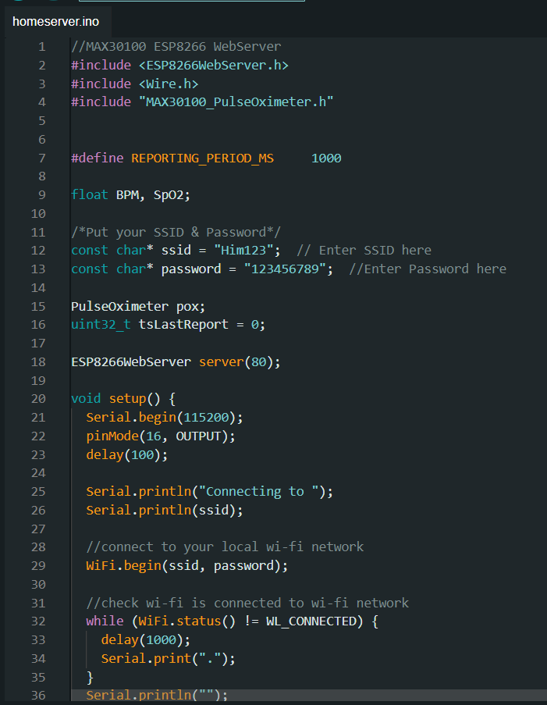
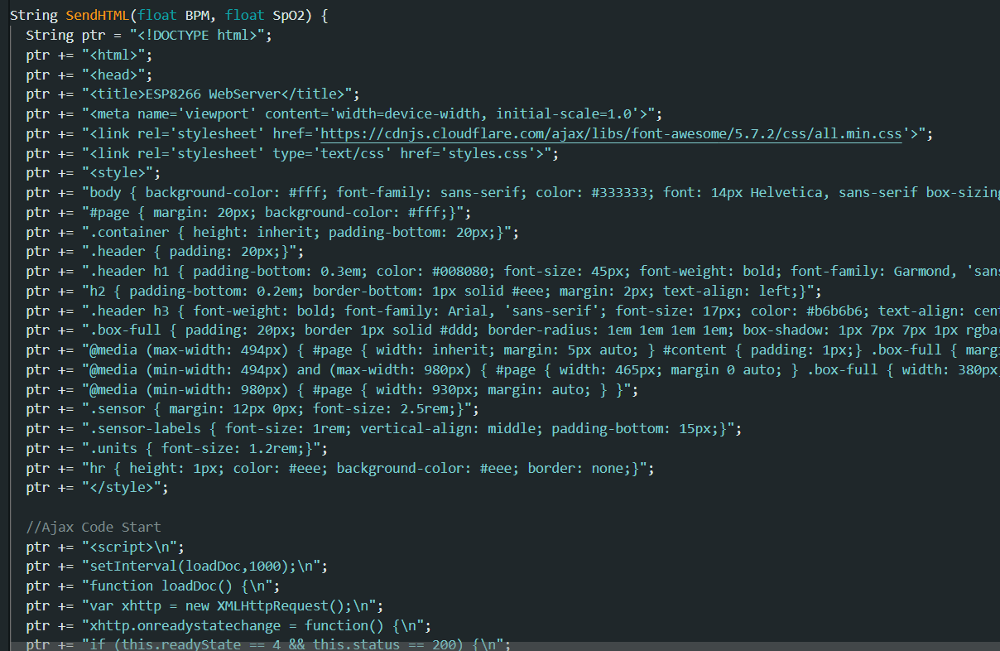
Server Code

Slide 11
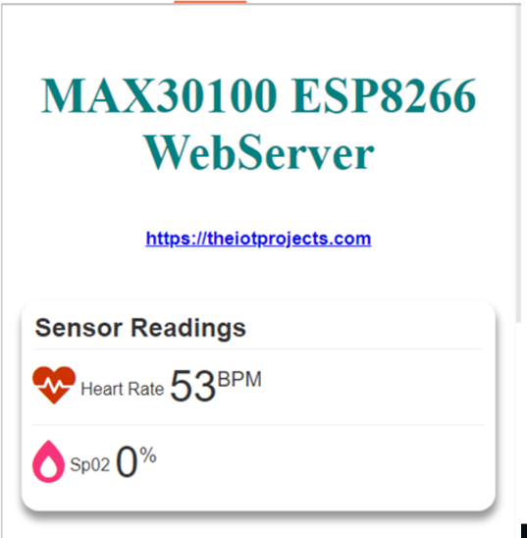
Server Code Output:

Slide 12
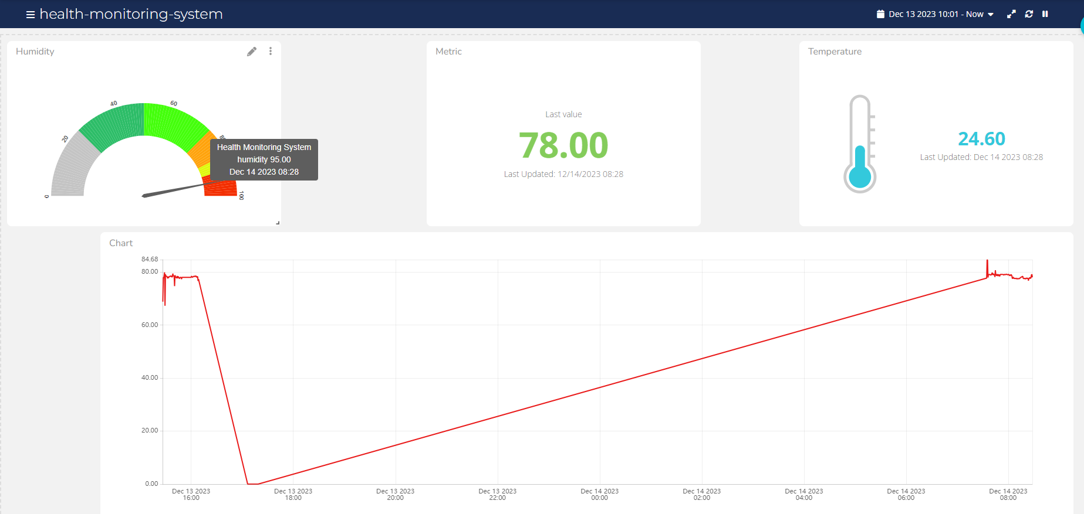
Ubidots
Dashboard:- Here we can keep the track of the monitoring target

Slide 13
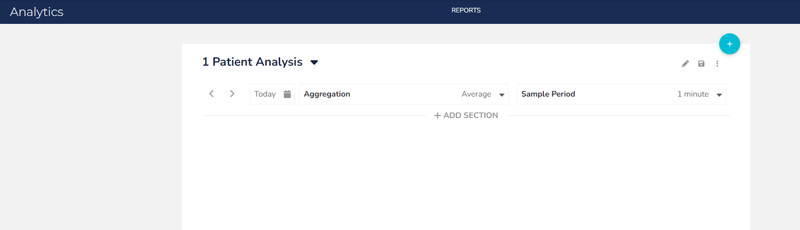
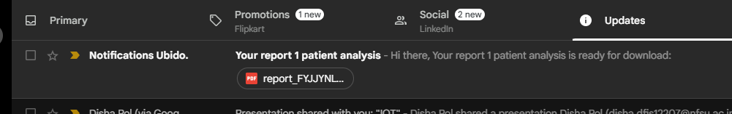
Patient Analysis Report send to DR.

Slide 14
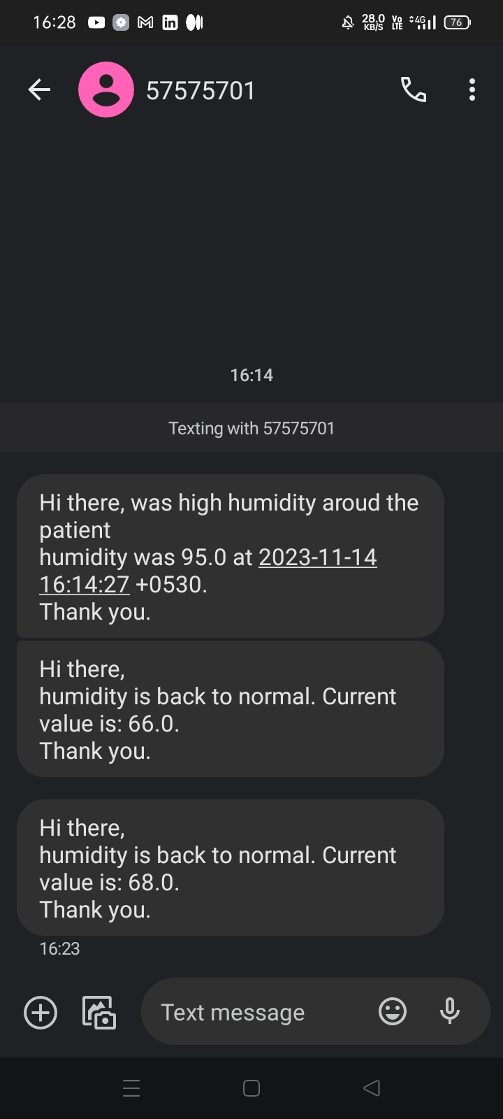
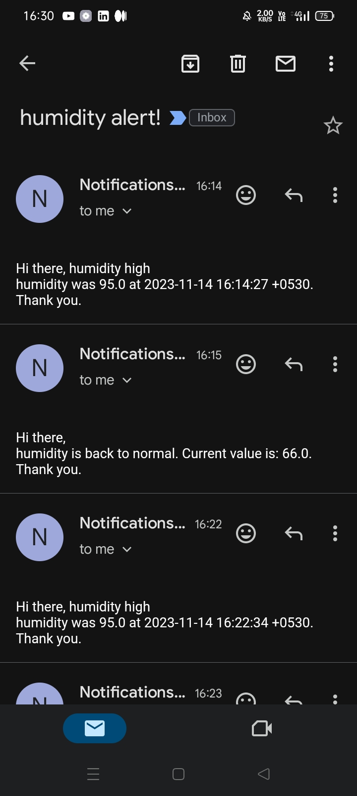
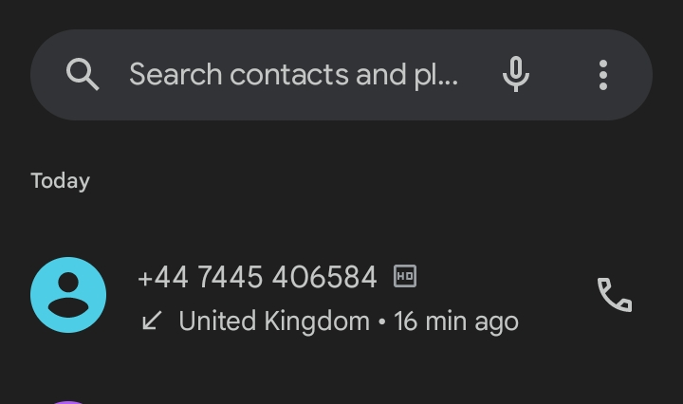
Notifications
We can configure and create the rest of the alerts like SMS, E-mail and Voice call we can recived both alert and back to normal alert also .

Slide 15
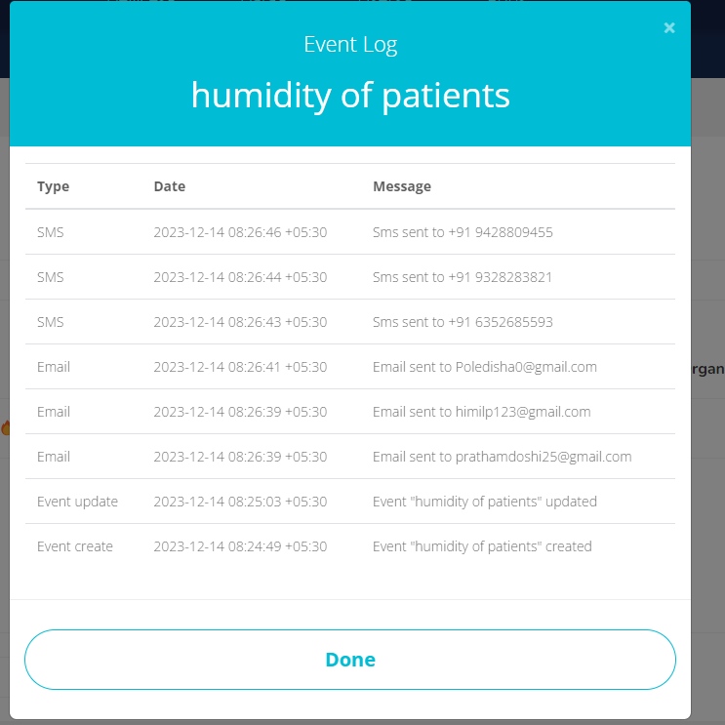
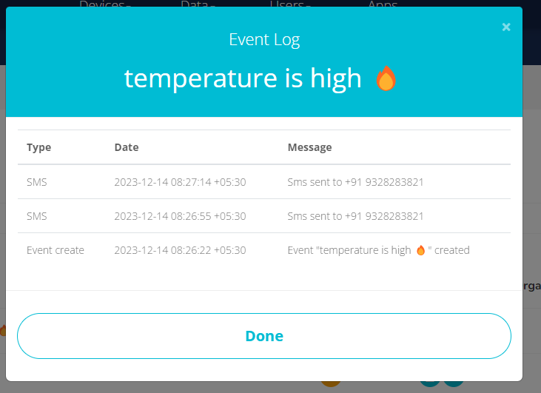
Logs of every event alert

Slide 16
Security Aspect
This type of project contains critical information so, here we can check the security in two way:
On esp8266 webserver
On cloud server

Slide 17
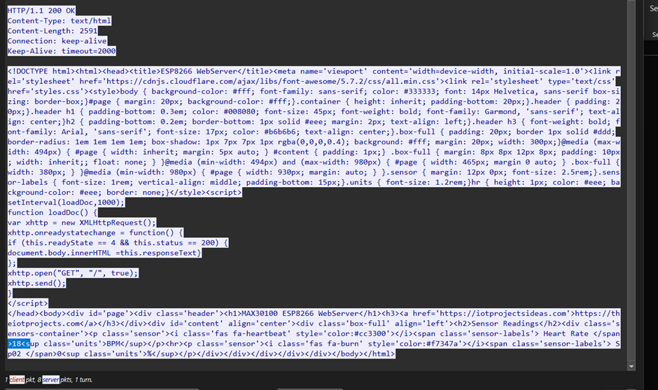
Esp8266 webserver
Wireshark TCP Stream

Slide 18
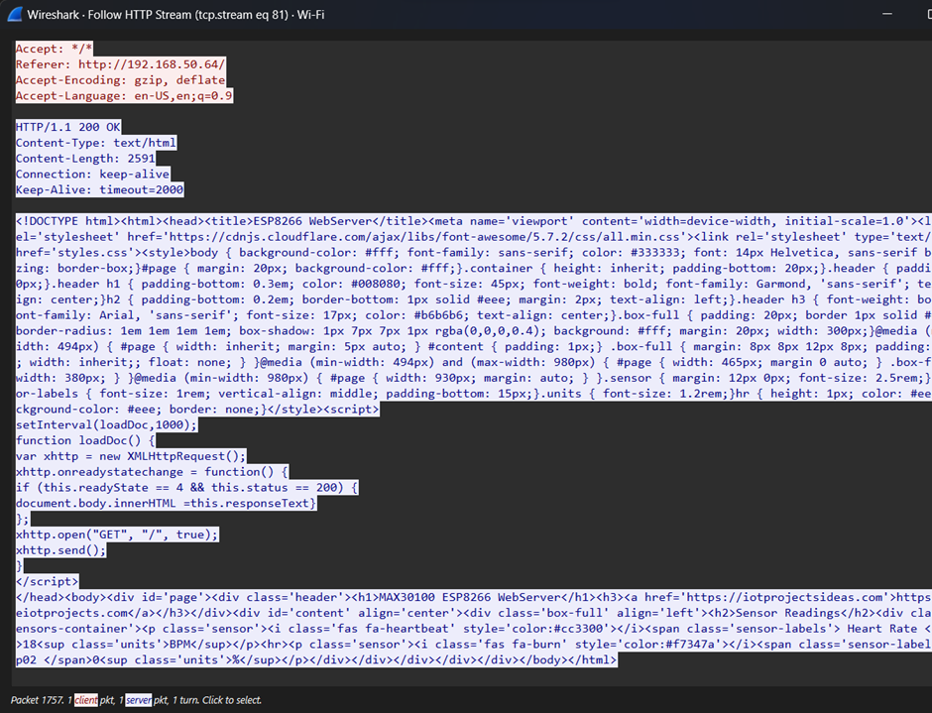
HTTP Stream

Slide 19
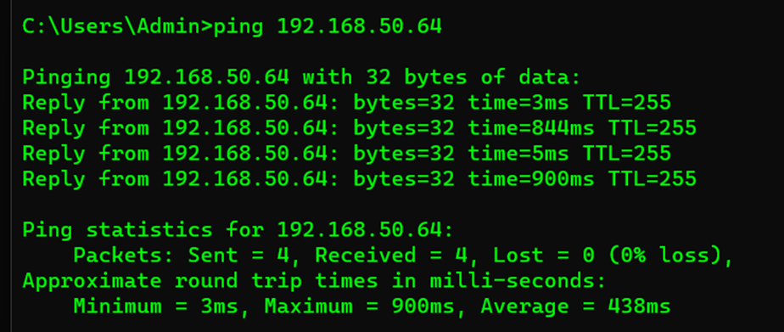
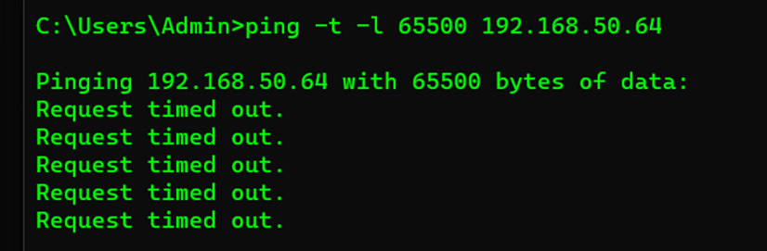
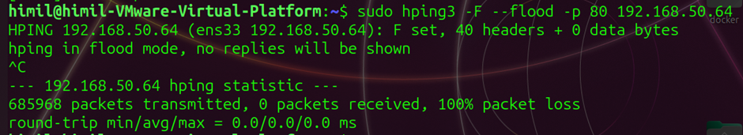
Ping check

Slide 20
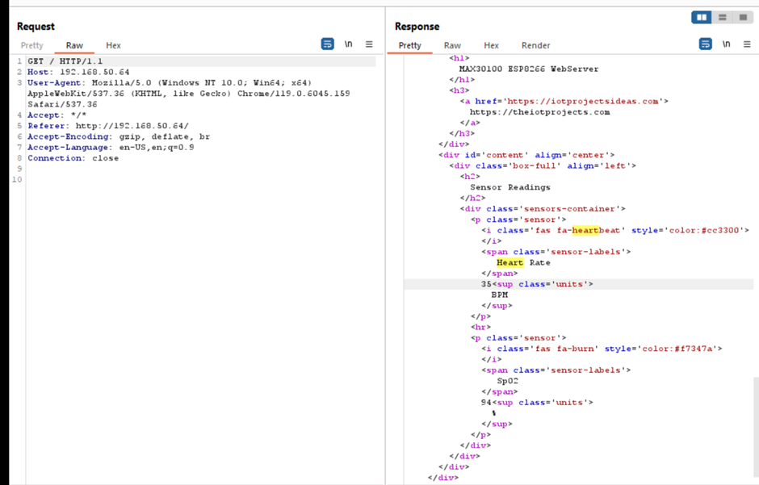
Burp suite

Slide 21
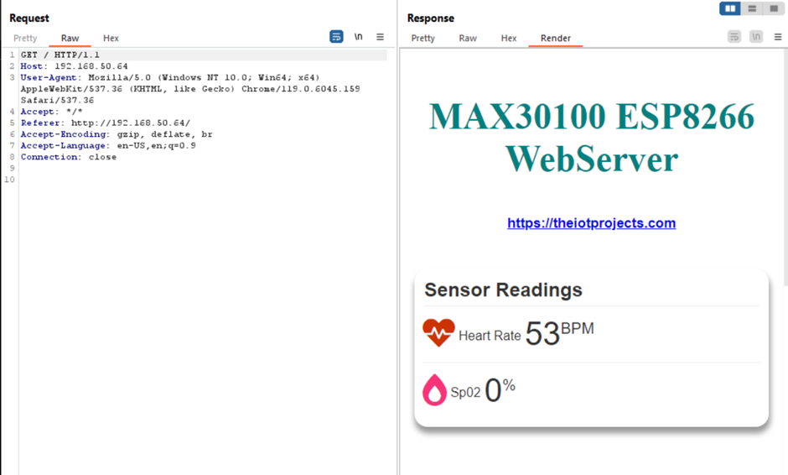

Slide 22
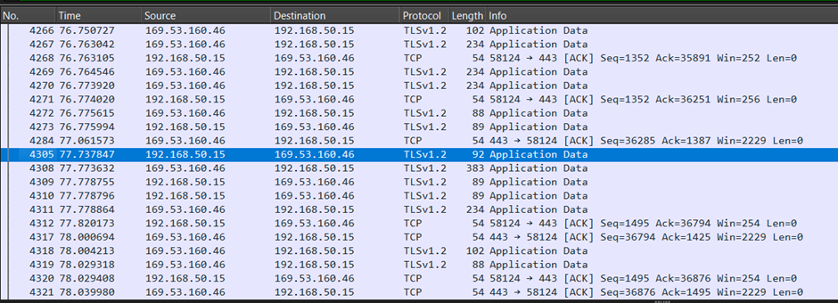
2. Cloud Server Security Check
Wireshark

Slide 23
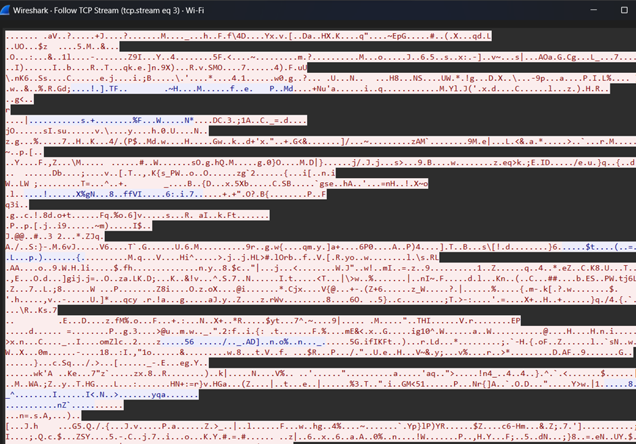

Slide 24
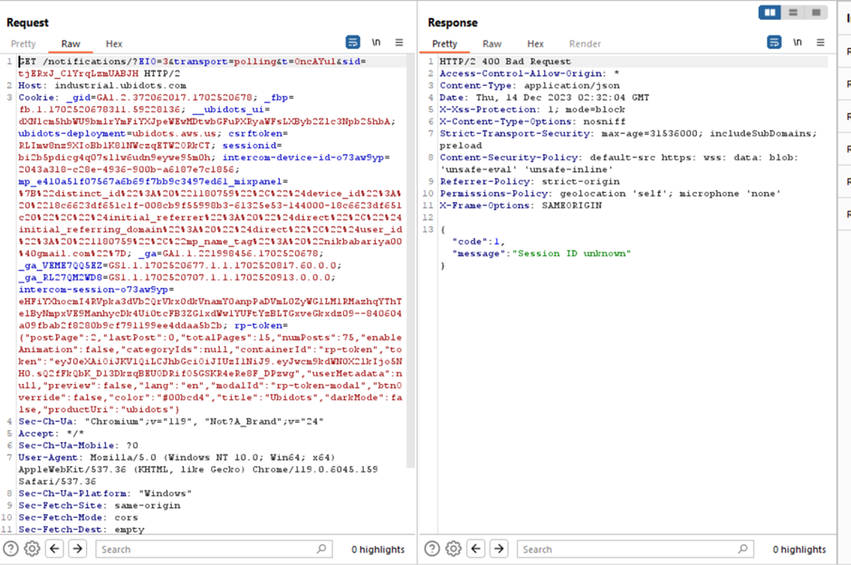

Slide 25
Findings
Sro.no | Name | DATA VALUES (visible or not) | Encrypted | Ping(DDOS) | Manipulation
1. | Cloud integration | × | ✓ | × | ×
2. | ON ESP8266 Server | ✓ | × | ✓ | ×

Slide 26

Future Scope
In future we can add the AI model into this so that AI can give you a predication of the human that he will suffering the heart base disease or not
This will help into the pandemic situation to monitor the patient remotely

Slide 27
Thank you

